Slide 1
Business Case Study

Slide 2
Tables to be Downloaded
Customers
Suppliers
Employees
Products
Shippers
Orders
Order_Details

Slide 3
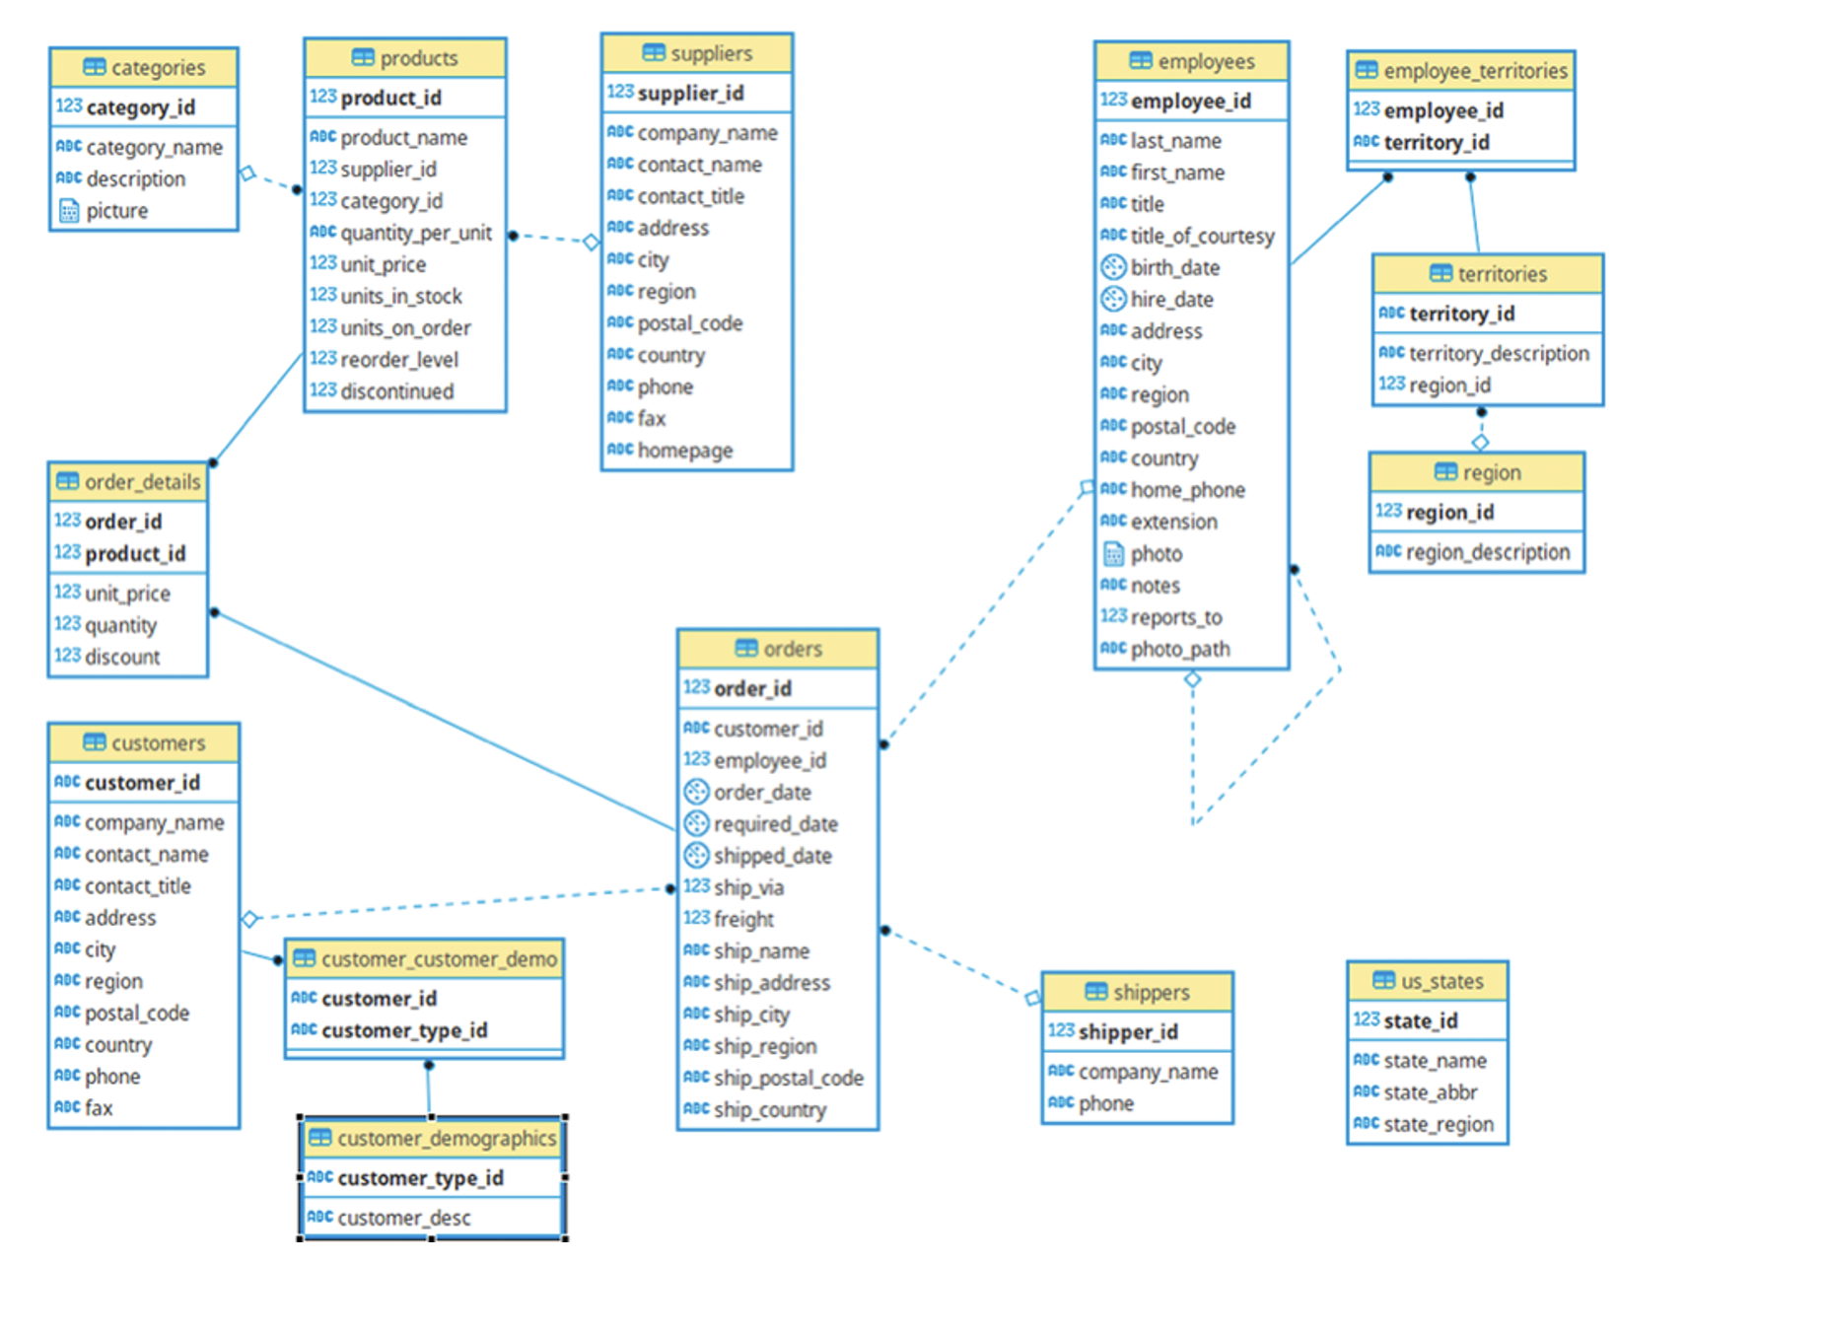
Schema

Slide 4
Ques1. Fetch the full name and hiring date of all Employees who work as Sales Representatives.
select
concat(firstname,' ',lastname) as full_name,
hiredate
from `business_case_study.employees`
where title = 'Sales Representative';

Slide 5
*Ques2. Which of the products in our inventory need to be reordered?
Note: For now, just use the fields UnitsInStock and ReorderLevel, where UnitsInStock is less than or equal to the ReorderLevel, ignoring the fields UnitsOnOrder and Discontinued.
select
productid,productname,unitsinstock,reorderlevel from
`business_case_study.products`
where unitsinstock <= reorderlevel
order by productid;

Slide 6
*Ques3. Find and display the details of customers who have placed more than 5 orders.
select * from `business_case_study.customers`
where customerid IN
(
select customerid from `business_case_study.orders`
group by customerid
having count(*) > 5
);
select c.customerid
from `business_case_study.customers` c
INNER JOIN `business_case_study.orders` o
USING (customerid)
group by c.customerid
having count(*) > 5;

Slide 7
*Ques4. An employee of ours (Margaret Peacock, EmployeeID 4) has the record of completing most orders. However, there are some customers who've never placed an order with her. Show all such customers.
select c.customerid,o.customerid
from `business_case_study.customers` c
LEFT JOIN `business_case_study.orders` o ON c.customerid = o.customerid
and o.employeeid = 4
where o.customerid is null;
select customerid from business_case_study.customers where customerid not in (
select customerid from business_case_study.employees join business_case_study.orders using(employeeid)
where employeeid=4
)

Slide 8
*Ques5. The developers at Cochin Traders are testing an app that the customers will use to show orders. In order to make sure that even the largest orders will show up correctly on the app, they'd like some samples of orders that have lots of individual line items. Display the top
10 orders with the most line items.
select
o.orderid,
COUNT(*) as total_order_details
from `business_case_study.orders` o
INNER JOIN `business_case_study.orders_details` od
ON o.orderid = od.orderid
GROUP BY o.orderid
order by total_order_details desc
LIMIT 10;
select orderid,count(*) as number from `business_case_study.orders_details`
group by orderid
order by number desc
limit 10;

Slide 9
*Ques6. Retrieve the top 5 best-selling products on the basis of the quantity ordered.
select
productname,
SUM(quantity) as total_qty
from `business_case_study.products` p
JOIN `business_case_study.orders_details` od
ON p.productid = od.productid
group by productname
order by total_qty desc
limit 5;

Slide 10
*Ques7. Analyze the monthly order count for the year 1997.
select
EXTRACT(MONTH FROM orderdate) as month,
COUNT(*) as ordercount
from `business_case_study.orders`
where EXTRACT(YEAR FROM orderdate) = 1997
group by month
order by month;

Slide 11
*Ques8. Calculate the difference in sales revenue for each month compared to the previous month.
WITH month_revenue AS
(
select
FORMAT_DATE('%Y-%m',orderdate) as monthdatayearwise,
ROUND(SUM(quantity * unitprice),2) as revenue
from `business_case_study.orders` o
INNER join `business_case_study.orders_details` od
ON o.orderid = od.orderid
group by monthdatayearwise
)
SELECT monthdatayearwise,revenue,
LAG(revenue) OVER(order by monthdatayearwise) as previousMnthrevenue,
ROUND(revenue - LAG(revenue) OVER(order by monthdatayearwise),2) as revenue_diff,
from month_revenue
order by monthdatayearwise;

Slide 12
*Ques9. Calculate the percentage of total sales revenue for each product.
#ans 9
SELECT
productname,
round(sum(od.unitprice * quantity),2) as revenue,
round(sum(od.unitprice * od.quantity)/ SUM(sum(od.unitprice * quantity)) OVER(),2) * 100 as revenuepercentage
from `business_case_study.products` p JOIN
`business_case_study.orders_details` od ON p.productid = od.productid
group by productname
order by revenuepercentage DESC;

Slide 13
*Ques10. Determine the cumulative percentage of total sales revenue for each month.
WITH monthly_revenue AS
(
select
FORMAT_DATE('%Y-%m',orderdate) as monthdatayearwise,
ROUND(SUM(quantity * unitprice),2) as revenue
from `business_case_study.orders` o
JOIN `business_case_study.orders_details` od
ON o.orderid = od.orderid
group by monthdatayearwise
)
select monthdatayearwise,revenue,
ROUND(SUM(revenue) OVER(order by monthdatayearwise)/ SUM(revenue) OVER(),2) * 100 as cum_sales
from monthly_revenue
order by monthdatayearwise;

